Slide 1
ENHANCING AMERICAN RETIREMENT NOW The EARN Act (aka SECURE 2.0)
Robert S. Keebler, CPA/PFS, MST, AEP

Slide 2
Bill Overview
Course Overview
This course will focus on the what the practitioner helping wealthy individuals needs to know.
Changes for the retirement saver
Changes for the retiree
This course will NOT cover changes from the employer’s perspective.
Individual Retirement
Retirees
Public Safety and Military
Nonprofits and Educators
Disaster Relief
Employer Plans
Notices, technical modifications, plan amendments, tax court proposals
Revenue Provisions

Slide 3
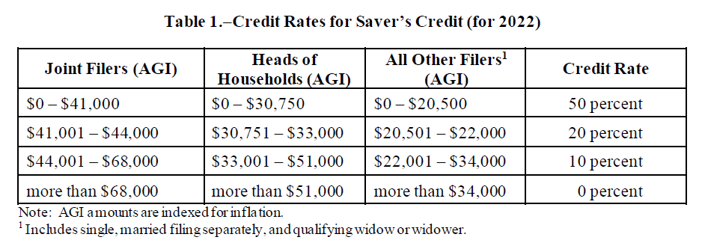
Changes to the: SAVER’S CREDIT
Current Law
Table created by the joint tax committee.
Act § 103

Slide 4
Changes to the: Saver’s CREDIT Match
SECURE 2.0
Refund made as a direct contribution to a retirement account
The credit would also be restructured:
Equal to 50% of up to $2,000 (not indexed) of contributions
Includes any elective/voluntary contributions; reduced by distributions over a 2-year testing period
The 50% rate would be phased-out to 0% over a MAGI range (indexed for inflation):
MFJ: $41,000 - $71,000
HoH: $30,750 - $53,250
Single: $20,500 - $35,500
Taxpayer must have attained age 18 and not claimed as a dependent
Effective starting in 2027
Act § 103

Slide 5
Required Beginning Date (RBD) Increase
Current Law
RMDs began at age 70½ before January 1, 2020 (i.e. before SECURE 1.0)
RMDs begin at age 72 current
SECURE 2.0
Year | RBD
2022 | 72
2023 - 2032 | 73
2033 | 75
Act § 107

Slide 6
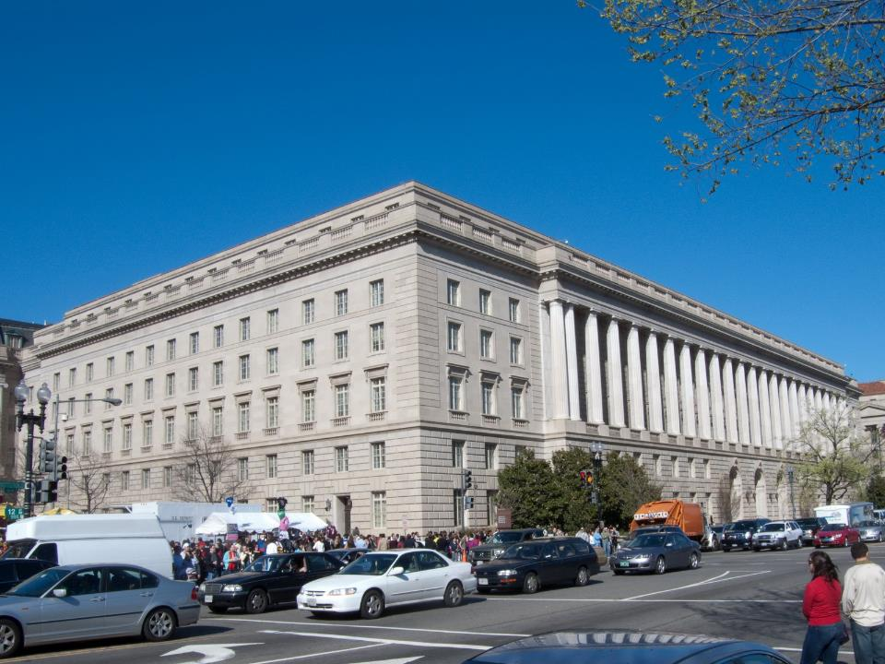
Indexing IRA Catch-up Limit
Current Law
Taxpayers over age 50 can contribute an additional $1,000 to their IRA annually
Applies to both Traditional & Roth IRAs
The $1,000 limit is not indexed for inflation
No income limitation
Each spouse may make the additional contribution
SECURE 2.0
Index the catchup limit for inflation
Effective starting in 2024
Act § 108

Slide 7
Higher Retirement Plan Catch-up Limits
Current law
Taxpayers over age 50 can contribute an additional $6,500 to their 401(k), 403(b) and 457(b) plans annually
SECURE 2.0
Change applies to those aged 60-63 (attained at least 60, but not 64 during the tax-year)
Increases the catch-up limit to $10,000 (basically; inflation adjustments apply)
Increases the catch-up limit for SIMPLE IRAs
ALL CATCHUP CONTRIBUTIONS TREATED AS ROTH CONTRIBUTIONS
Effective starting in 2025
Act § 109

Slide 8
Higher Retirement Plan Catch-up Limits
401k Contribution Limit Example – 2025 Projection
Age | Elective Deferral Limit | Catch-up Limit | Total Elective Deferral
Under 50 | $25,000 | - | $25,000
50-59 | $25,000 | $8,000 | $33,000
60-63 | $25,000 | $12,000 | $37,000
Over 63 | $25,000 | $8,000 | $33,000
WARNING – These figures are calculated using inflation estimates; mere rough numbers to illustrate the complicated difference by age.

Slide 9
Matching for Student Loan Payments
SECURE 2.0
Treat student loan payments as contributions in order to be eligible for an employer match
Treatment limited to the elective deferral limit, reduced by any actual elective deferrals
Available for 401(k) plans, 403(b) plans, 457(b) plans and SIMPLE IRAs
For testing purposes: student loans payments will not be treated as a contribution, however they will be considered an elective deferral
Employers will need to update plans
Plan administrators can rely on the employee’s certification
Effective starting in 2024
Act § 110

Slide 10
Emergency Expense Withdrawals
SECURE 2.0
A new penalty-free distribution for personal or family emergency expenses
Limited to the lesser of: $1,000 or the non-forfeitable account balance in excess of $1,000
Limited to one distribution every 3-years unless the previous recent distribution is re-contributed
Available for: Qualified retirement plans, 403(b) plans, 457(b) plans, and IRAs
Plan administrators can rely on the employee’s certification
Effective starting in 2024
Act § 115

Slide 11
SIMPLE Plan Contribution Limits
Current Law
Sponsored by small employers (100 or fewer employees)
Employer match required (3% of contributions or 2% of compensation)
The 2022 contribution limit is $14,000;
And the 2022 catchup limit beginning at age 50 is $3,000
SECURE 2.0
Increases the catch-up limit by 10%
Requires certain employers to increase match
Effective starting in 2024
Act § 117

Slide 12
SEP for Non-Trade or Business
SECURE 2.0
Permits employers of domestic employees (e.g., nannies) to provide retirement benefits via a SEP
Effective starting in 2023
Act § 118

Slide 13
ABLE Accounts
Current Law
Requires certain eligible individuals to be disabled before age 26
SECURE 2.0
Changes the age the disability must occur to before age 46
Effective beginning in 2026
Act § 124

Slide 14
529 to Roth Rollovers
Current law
No mechanism to rollover unused 529 funds to retirement accounts
SECURE 2.0:
Allows for rollovers 529 plan funds to Roth IRAs
529 must be maintained for at least 15-years before the rollover
Roth rollovers limited to the aggregate contributions (and attributable earnings) made at least 5-years before the date of the distribution
Must be a direct, trustee-to-trustee transfer to a Roth IRA account maintained for the benefit of the 529 plan beneficiary
Rollover limited to the $6,000 contribution limit (adjusted for inflation)
Regular IRA contributions reduce eligible 529 rollovers
Roth income limits don’t seem to apply
Overall aggregate lifetime limit of $35,000
Earnings and contributions from the 529 plan carryover for the Roth ordering rules
Effective starting in 2024
Act § 126

Slide 15
Remove RMD Barriers for Life Annuities
Current law
Limitations of annuities in plans
SECURE 2.0:
Allows for certain increasing annuity payments and lump-sum payments
Effective starting 2023
Act § 201

Slide 16
Qualifying Longevity Annuity Contracts
Current law
QLAC is fixed annuity that allows RMD deferral
In 2022, a QLAC is limited to the lesser of 25% of their retirement funds or $145,000
SECURE 2.0:
Eliminate the 25% limitation
Increase dollar limitation to $200,000 in 2023 (will inflation adjusted thereafter)
Other technical changes
Act § 202

Slide 17
Failed RMD Penalty
Current Law
50% excise tax (basically a penalty) on failed RMDs
Excise is in addition to income tax assessed on the distribution
SECURE 2.0:
Reduces the excise tax to 25%
10% in the case of timely corrections – the “correction window”
Before the mailing date of a notice of deficiency
Before the date the 25% excise tax is assessed
Before the end of the third calendar year of when the tax was imposed
Effective starting in 2023
Act § 302

Slide 18
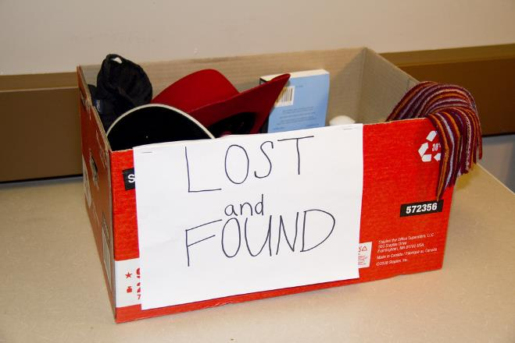
Retirement Plan Lost & Found
The proposal would require Treasury to create an online searchable database
Act § 303

Slide 19
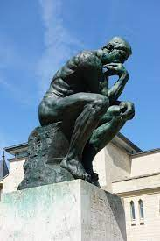
Expansion of Employee Plans Compliance Resolution System
Current Law
Employee Plans Compliance Resolution System (EPCRS) – allows for self-correction of inadvertent errors
SECURE 2.0
Expands the system to IRA custodians
Act § 305

Slide 20
One-Time CRT Contribution
SECURE 2.0
One time election to fund a CRT (or charitable gift annuity) with an IRA distribution
Limited to $50,000 (adjusted for inflation)
Income interest must be payable to account owner or spouse
The IRA distribution qualifies as a QCD to a CRT to the extent the contribution would qualify as deductible under Section 170 (i.e. to the extent the remainder interest exceeds the present interest)
Effective starting in 2023
Act § 307

Slide 21
Repayment of Qualified Birth or Adoption Distributions
Current Law
Qualified birth and adoption distributions are exempt from the 10% penalty
Repayments of these distributions are allowed
SECURE 2.0
Limits repayments to a 3-year window (provides clarity)
Act § 311

Slide 22
Self-Certified Hardship Distributions
SECURE 2.0
Allow employers to rely on employee certification that hardship distribution conditions are met
Act § 312

Slide 23
IRA Excise Tax Statute of Limitations
Current Law
There is not statute of limitations (SOL) for excise tax on excess contributions and accumulations
SECURE 2.0
3-year period if the taxpayer is not required to file a return
6-year period if the taxpayer filed an income tax return
No SOL for certain acquisitions
Act § 313

Slide 24
Penalty-Free Withdraws for Domestic Abuse
SECURE 2.0
Adds an exception to the 10% early withdraw penalty for domestic abuse victims
Exception applies to a 1-year period after the abuse
Exception limited to the lessor of:
$10,000 OR
50% of the account value
Allow domestic abuse victim distributions to be recontributed within three years after the day it was it was received
Self-certification procedures
Effective 2024
Act § 314

Slide 25
IRA Prohibited Transactions
Current Law
PT disqualifies entire IRA
IRA immediately fully taxable as if distributed
SECURE 2.0
Allows IRAs to be considered separately
Effective 2023
Act § 322

Slide 26
SEPP Clarifications
Current Law
A Series of Substantially Equal Periodic Payments (SEPPs) is an exception to the 10% early withdrawal penalty for pre-59½ distributions
Payments must be computed according to one of three permissible methods
However, under current law, if the series of payments is modified or terminated within 5-years of starting or before age 59½ the entire series of payments is subject to the 10% penalty; modifications include
Change in the payment amount (generally)
Additional funds contributed or rolled over to the account
Rollover of the account to another plan
SECURE 2.0
Allows rollovers to occur and not be considered a modification to the SEPP, provided the payments continue as required as if the rollover didn’t occur
Includes relief for certain SEPP annuities and provides relief for certain reporting requirements

Slide 27
Elimination of Addition Tax on Corrective Distributions of Excess Contributions
Current Law
The 10% early distribution penalty can apply if a corrective distribution is made to remove an excess contribution
SECURE 2.0
Exempts corrective distributions of excess contributions from the 10% penalty
To be eligible for the exemption:
The corrective distribution (with any income earned thereon) must be distributed by the return due date (including extensions)
The taxpayer did not claim a deduction for the excess contribution
Effective 2024
Act § 323

Slide 28
Treasury Guidance on Rollovers
Current Law
“Bungled” rollovers are common and difficult to correct
SECURE 2.0
Requires the Secretary to develop and release sample forms no later than 1/1/2025
Forms would be for:
Direct rollovers from employer plans to another employer plan or IRA
Trustee to trustee transfers from an IRA to another IRA or retirement plan
Act § 324

Slide 29
Roth Plan Distributions
Current law
RMDs apply to qualified Roth contribution programs (e.g. Roth 401k elective deferrals)
However, retirees can avoid RMDs by rolling over plan assets into Roth IRAs
SECURE 2.0:
Removes RMDs for qualified Roth contribution programs – during life
Equalizes treatment to Roth IRAs
Effective 2024
Act § 325

Slide 30
Terminal Illness Exception
SECURE 2.0
Creates a new exception to the 10-percent early withdrawal penalty tax for terminal illness
Terminally ill individual means an individual who has been certified by a physician as having an illness or physical condition that can reasonably be expected to result in death in 84 months or less after the date of the certification
Effective to distributions made after enactment
Act § 326

Slide 31
Surviving Spouse Election to be Treated As Employee
SECURE 2.0
Permits a Surviving Spouse of an employee who dies before RMDs begin to elect to be treated as the employee to determine when distributions begin.
Also permits the spouse to apply the present-law rule that treats the spouse as the employee for purposes of determining the distribution period in cases where the spouse dies before distributions begin.
Effective starting in 2024
Act § 327

Slide 32
Long-term Care Contracts
SECURE 2.0
Repeals government plan direct pay requirement for long-term care insurance
Payments to the insured, who in turn pays the premium permitted
Reporting merely requires an attestation that the reduced taxable amount is correct
Applies to distributions made after enactment
Act § 328

Slide 33
Early Withdrawal Penalty Exemption Age
Current law
Qualified public safety employees can avoid the early withdraw penalty at age 50
IRC § 72(t)(10)
SECURE 2.0
Statutory change: “Age 50 or 25 years of service under the plan, whichever is earlier”
Adds certain corrections employees to the exemption
Effective to distributions made after enactment
Act § 329 - 330

Slide 34
Federally Declared Disasters
Current law
On an event-by-event basis, Congress has allowed those suffering from a disaster to access their retirement funds without penalty
SECURE 2.0
Adds IRC § 72(t)(11)
Allows for penalty-free distributions within 180-days of a Presidentially declared disaster
To those who principal place of abode is located in the disaster area (as declared)
And who sustained an economic loss by reason of the disaster
Penalty-free distributions in all taxable years limited to $22,000
Distribution income recognized ratably over a 3-taxable year period; election out available
3-year repayment period beginning the day after the distribution
Allows for $100,000 plan loans (compared to the $50,000 general limit)
Act § 331

Slide 35
Elimination of Additional Tax on Corrective Distributions of Excess Contributions
Current law
The 10% early distribution penalty can apply to corrective distributions
SECURE 2.0
Adds IRC § 72(t)(2)(ix) to the list of distributions to which the early distribution penalty doesn’t apply to
New statutory language: [the 10% penalty shall not apply to distributions:] “attributable to withdrawal of net income attributable to a contribution which is distributed pursuant to section 408(d)(4).’’
408(d)(4) applies to contributions returned before the return due date
New law applies to any determination of tax after enactment
Act § 333

Slide 36
Long-term Care Contracts
SECURE 2.0:
Permits a defined contribution plan to allow for distributions to purchase qualified long-term care insurance
Limit: premium paid, 10% of the accrued benefit, or $2,500 (inflation adjusted)
These distributions would be includable in income, but exempt from the 10-percent penalty
Act § 334

Slide 37
“Inherited” IRAs Payable to Special Needs Trusts
Current Law:
SECURE 1.0 required “inherited” IRAs to be distributed within 10-year, however it exempted disabled beneficiaries and instead allows them to be life expectancy-based distributions
However, the proposed regulations implementing this failed to find a solution for IRAs payable to Special Needs Trusts (SNT) to make life-expectancy based distributions
SECURE 2.0:
Fixes this problem by allowing a SNT to have a charitable beneficiary and remain a qualified designated beneficiary (a charity usually causes the trust to fail because the actual persons who could potentially receive the retirement funds can’t be identified)
The problem may remain for some trusts that can make distributions to other family members before the death of the disabled beneficiary
Effective starting in 2023
Act § 337

Slide 38
SIMPLE & SEP Roth IRAs
Current Law
No Roth contributions to Simple and & SEP IRAs
SECURE 2.0
Allows SIMPLE and SEP Roth contributions
Revenue raising provision of the act
Effective beginning in 2023
Act § 601

Slide 39
Catch-up Elective Deferrals Limited to Regular Contribution Limit
Current Law
Catch-up contributions available to those age 50 and over are generally pre-tax
But can be designated as Roth (after-tax) contributions
SECURE 2.0
No deductible catch-up contributions from employees with wages from the employer exceeding $145,000
Prior year wage figure applies
Indexed for inflation
Limited employees can still make designated Roth contributions, if the plan allows for it
Revenue raising provision of the act
Effective beginning in 2024
Act § 603

Slide 40
Roth Employer Match
Current Law
Employer matches are all pre-tax
SECURE 2.0
Allows employer match to be Roth (optionally)
Revenue raising provision of the act
Available for contributions made after enactment
Act § 604

Slide 41
Charitable Easements
Current Law
Allows for tax-planning that is arguably abusive or simply is abusive
SECURE 2.0
Adds a limitation in IRC § 170(h)(7)
Contribution cannot exceed 2.5 times the sum of each partner’s basis in the partnership
Complicated exceptions and basis calculations
Exceptions for family partnerships
Exceptions to preserve historic structures
Expanded statute of limitations
Additional reporting requirements
Safe-harbor to correct deed errors
Applies to contributions made after the effective date
Act § 605

Slide 42
Conclusion

